Slide 1
Lecture 1: Welcome to CS106L!
CS106L, Spring 2025

Slide 2
Today’s Agenda
Introductions!
The Pitch 🦈 🦈
Course Logistics

Slide 3
Introductions

Slide 4
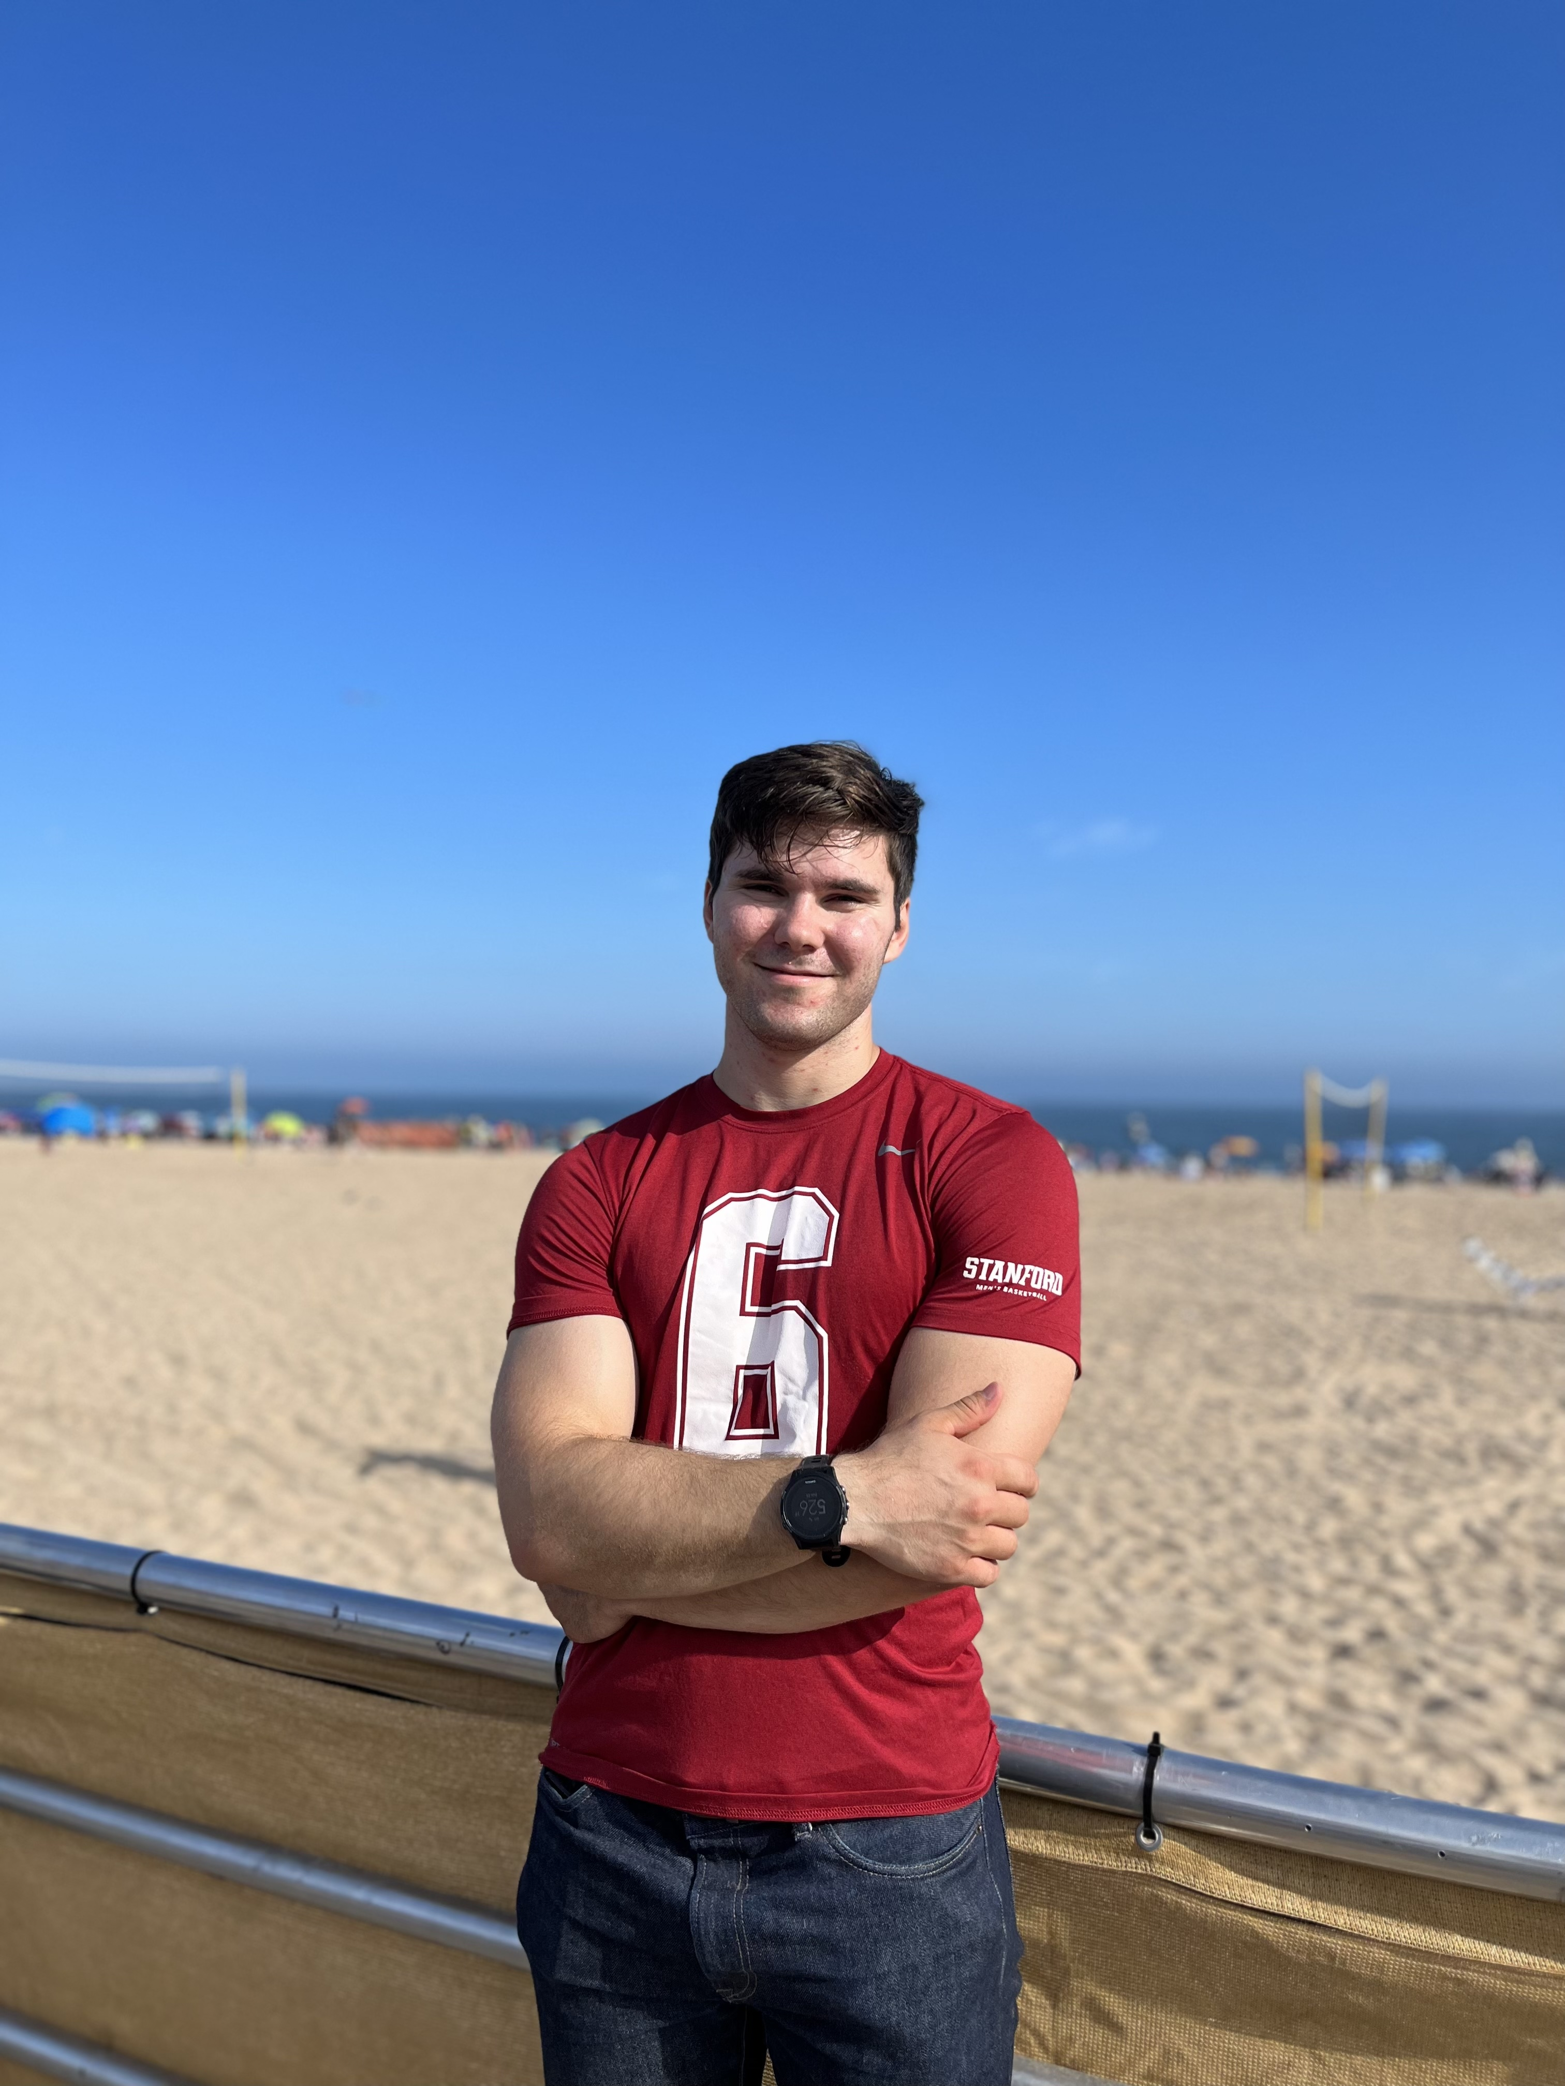


Slide 5
Now you can meet (some of) each other!
Turn to the people next to you and introduce yourselves!
Potential Conversation Topics:
What's something you're into and not into?
Why do you want to take this class?

Slide 6
The Pitch 🦈🦈

Slide 7
Why C++?

Slide 8
“The invisible foundation of everything”

Slide 9
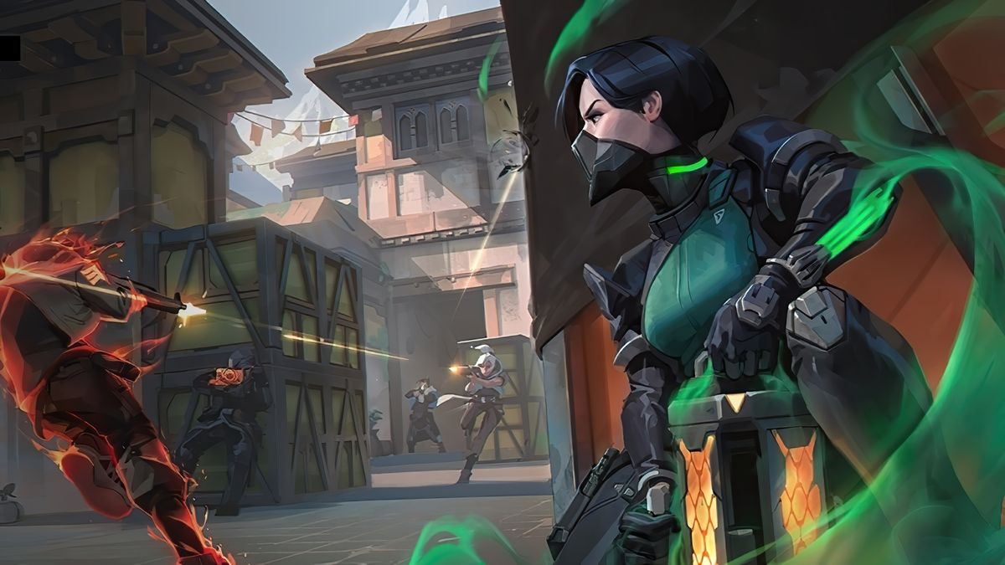
Valorant
[source]

Slide 10

CS: GO 2
[source]

Slide 11






…and many more!

Slide 12
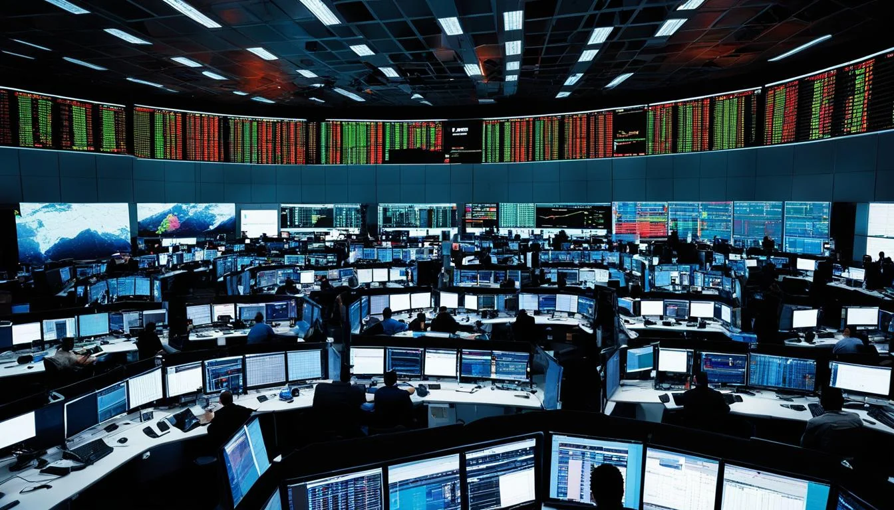



High Frequency Trading
[source]

Slide 13
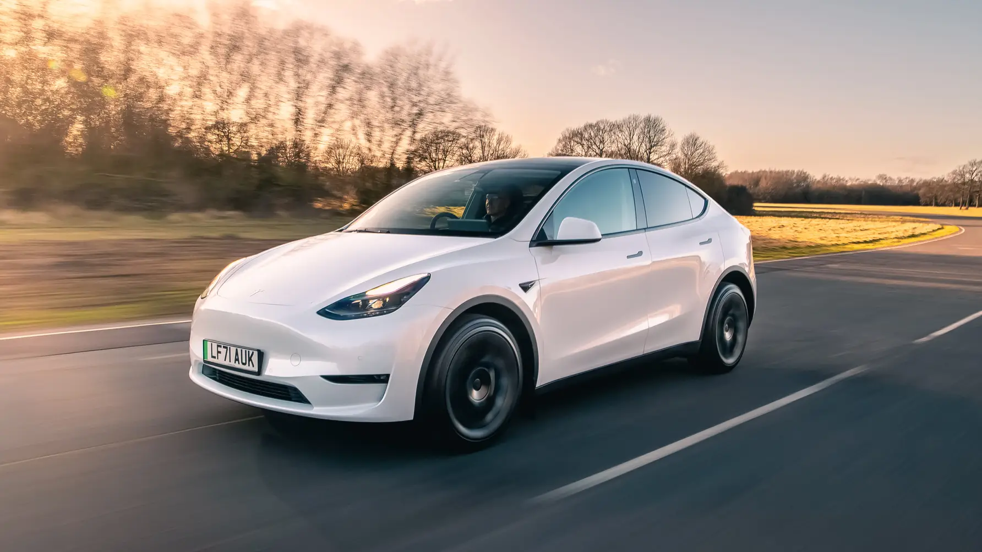


Self Driving
[source]

Slide 14

GPU Programming
[source]

Slide 15
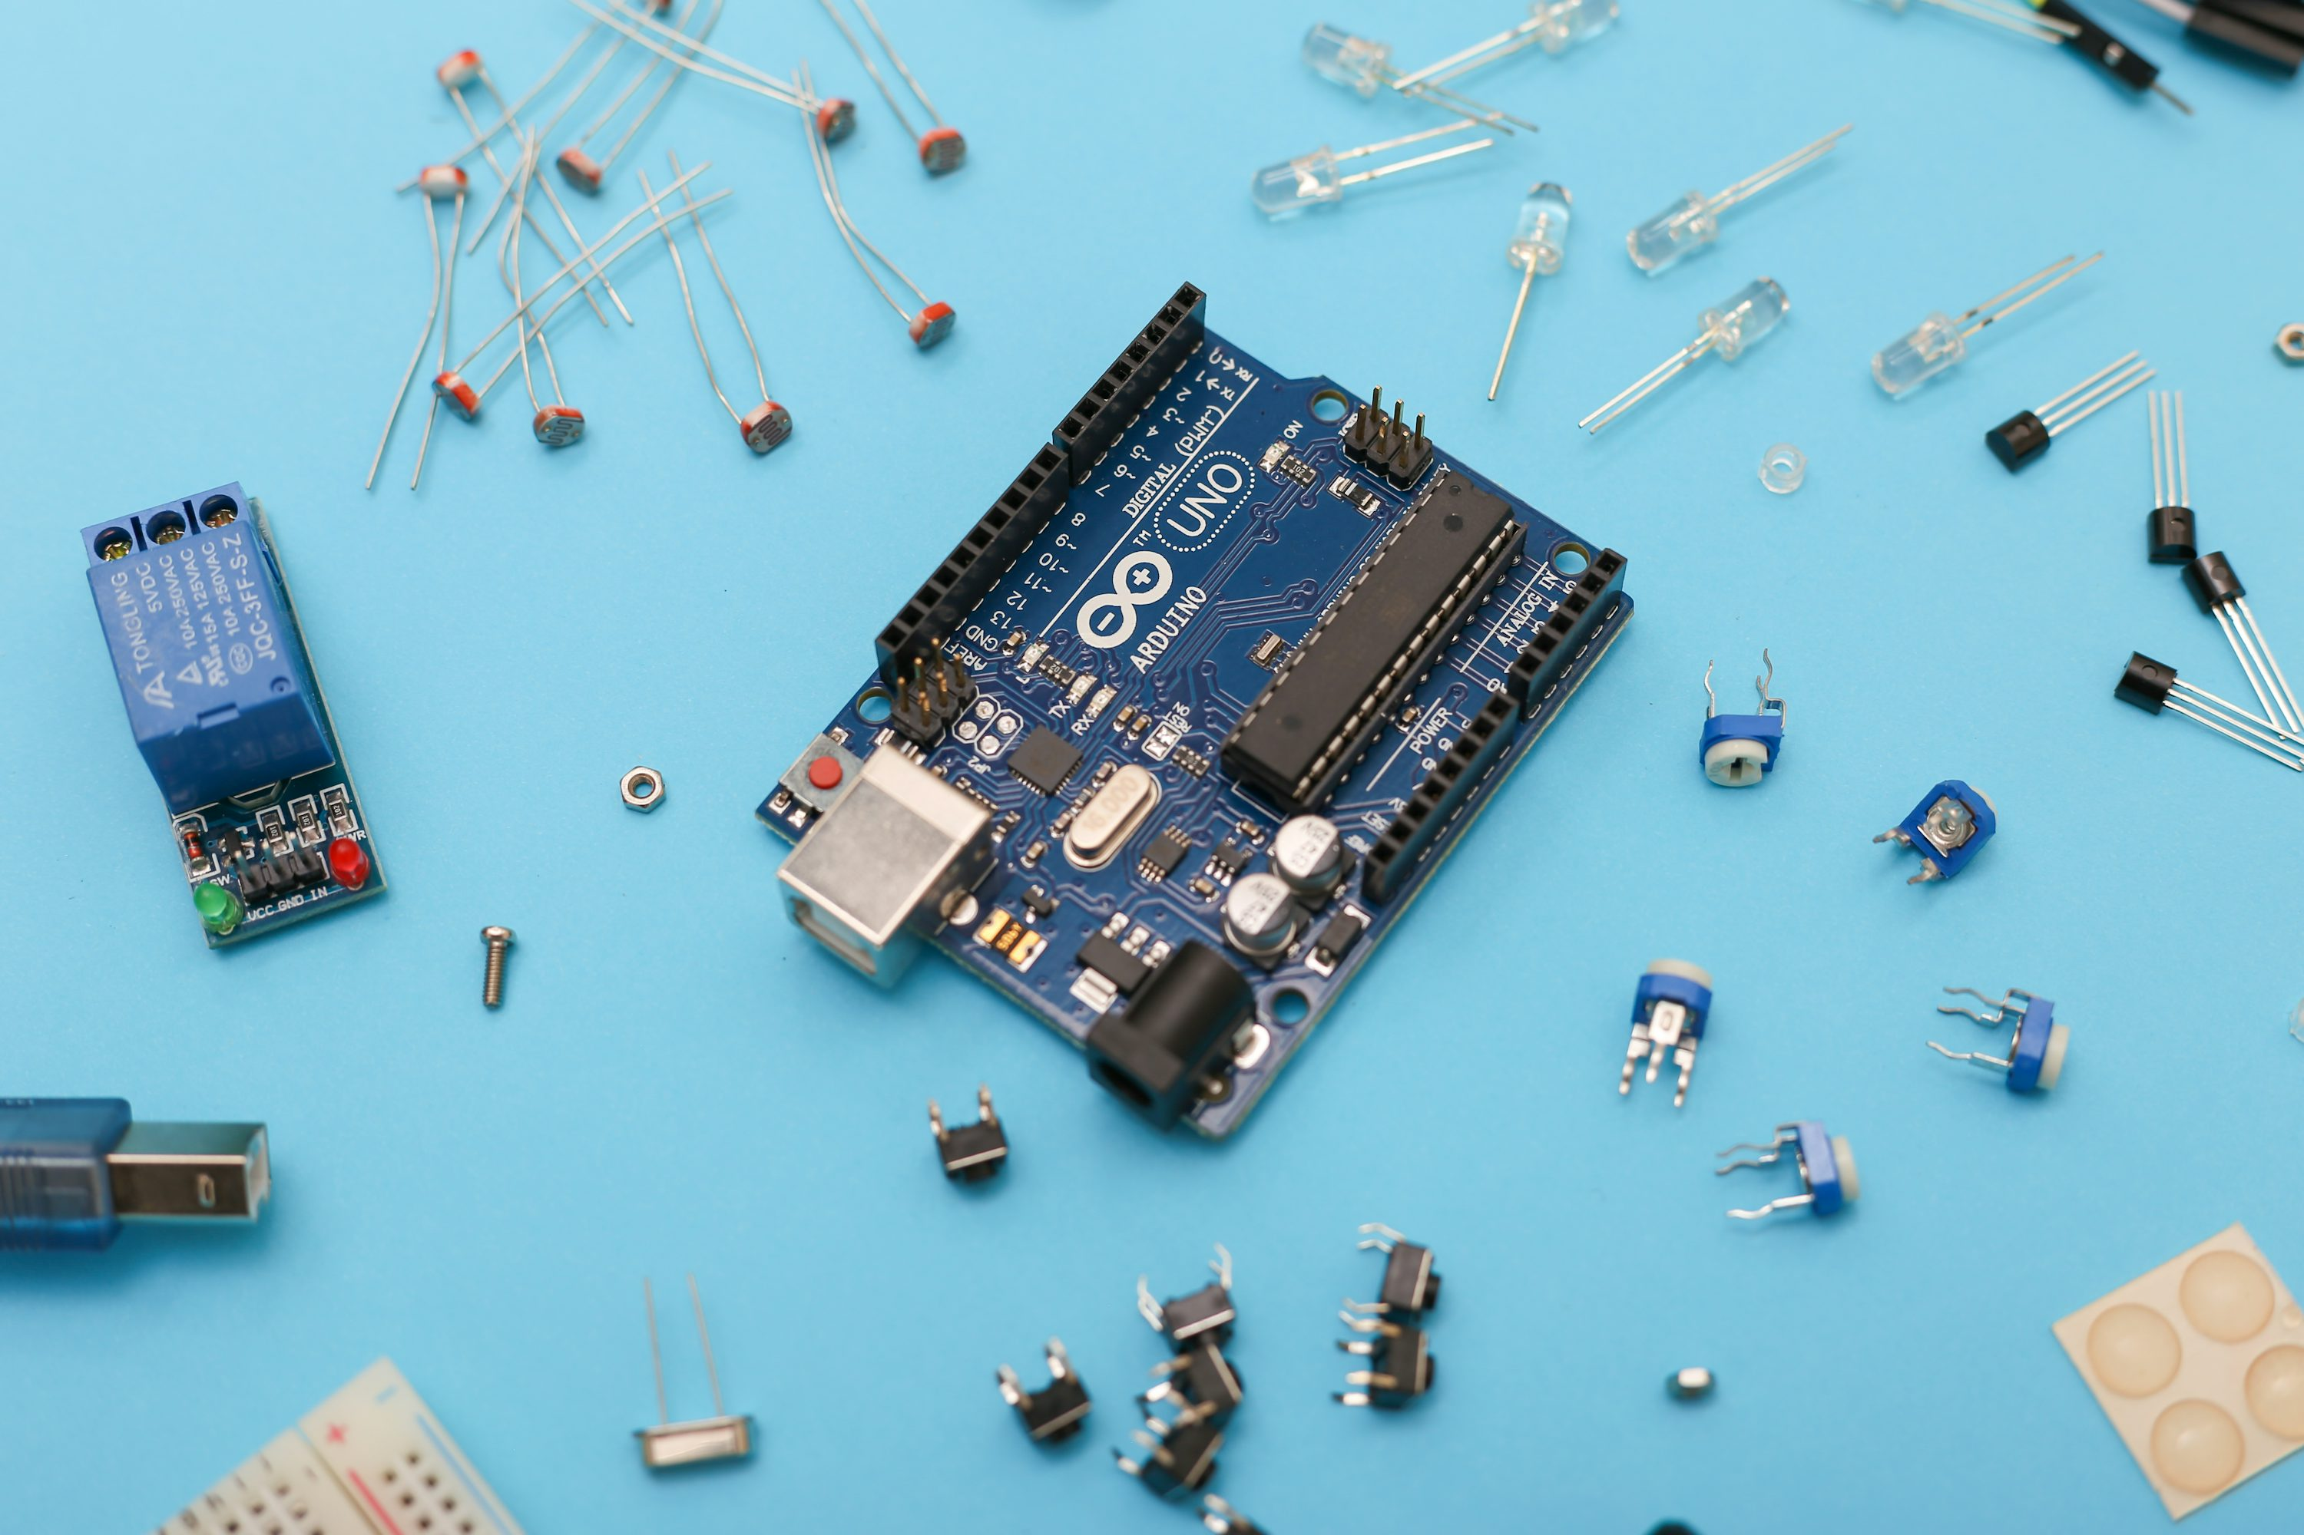

Arduino
[source]

Slide 16
And much, much more!
Databases (MySQL, MongoDB)
Web Browsers (Chrome, Safari, Edge)
Virtual Reality (Quest)
Low level ML (PyTorch, TensorFlow)
Compilers, virtual machines (JVM, LLVM, GCC)
Operating Systems (Windows)

Slide 17
“The invisible foundation of everything”

Slide 18
C++ is great for…
Handling lots of data
And handling it very efficiently
And doing it in an elegant, readable way

Slide 19






C++ in Industry

Slide 20
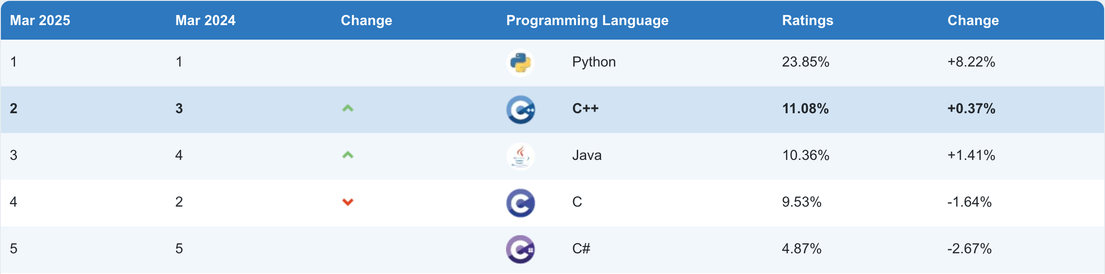
C++ was created in 1983, still #2!
[TIOBE Index, March 2025]

Slide 21
The C++ Community
C++ has a MASSIVE user base
C++ Standard continues to be revised every three years
We are here!
C++
C++03
C++14
C++20
C++26
1979
1983
1998
2003
2011
2014
2017
2020
2023
C++98
C++11
C++17
C++23

Slide 22
What is C++?

Slide 23
A valid C++ program
#include <iostream>
#include <string>
int main() {
auto str = std::make_unique<std::string>("Hello World!");
std::cout << *str << std::endl;
return 0;
}
// Prints "Hello World!"

Slide 24
Also a valid C++ program
C++ is backwards compatible with C. Neat!
#include "stdio.h"
#include "stdlib.h"
int main(int argc, char *argv) {
printf("%s", "Hello, world!\n");
// ^a C function!
return EXIT_SUCCESS;
}

Slide 25

Also a valid C++ program
#include "stdio.h"
#include "stdlib.h"
int main(int argc, char *argv) {
asm(".LC0:\n\t"
".string \"Hello, world!\"\n\t"
"main:\n\t"
"push rbp\n\t"
"mov rbp, rsp\n\t"
"sub rsp, 16\n\t"
"mov DWORD PTR [rbp-4], edi\n\t"
"mov QWORD PTR [rbp-16], rsi\n\t"
"mov edi, OFFSET FLAT:.LC0\n\t"
"call puts\n\t");
return EXIT_SUCCESS;
}

Slide 26
C++ History: Assembly
section .text
global _start ;must be declared for linker (ld)
_start: ;tell linker entry point
mov edx,len ;message length
mov ecx,msg ;message to write
mov ebx, 1 ;file descriptor (stdout)
mov eax, 4 ;system call number (sys_write)
int 0x80 ;call kernel
mov eax, 1 ;system call number (sys_exit)
int 0x80 ;call kernel
section .data
msg db 'Hello, world!' ,0xa ;our dear string
len equ $ - msg ;length of our dear string

Slide 27
C++ History: Assembly
✅ Unbelievably simple instructions
✅ Extremely fast (when well-written)
✅ Complete control over your program

Slide 28
Why don’t we always use assembly?

Slide 29
C++ History: Assembly
✅ Unbelievably simple instructions
✅ Extremely fast (when well-written)
✅ Complete control over your program
❌ A lot of code (even for simple tasks)
❌ Very hard to understand
❌ Extremely unportable

Slide 30

C++ History: Invention of C
Dennis Ritchie created C in 1972 to much praise.
C made it easy to write code that was:
Fast
Simple
Cross platform
Compilers! Source Code → Assembly
Learn to love it in CS107!
Dennis Ritchie (left), alongside Ken Thompson (right)

Slide 31
C++ History: Invention of C
C was popular because it was simple
“When I read C I know what the output Assembly is going to look like”
—Linus Torvalds, creator of Linux
However, C has some weaknesses:
No objects or classes
Difficult to write generic or templated code
Tedious to write large programs

Slide 32
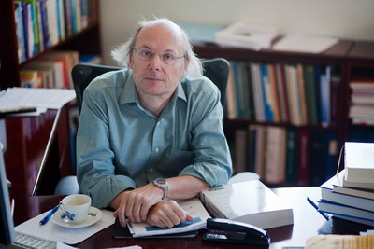
C++ History: Welcome to C++!
In 1983, the beginnings of C++ were created by Danish computer scientist Bjarne Stroustrup
He wanted a language that was
Fast
Simple to use
Cross-platform
Had high level features
Bjarne Stroustrup, the man himself ☺

Slide 33
C++ Design Philosophy
Express ideas and intent directly in code.
Enforce safety at compile time whenever possible.
Do not waste time or space.
Compartmentalize messy constructs.
Allow the programmer full control, responsibility, and choice.

Slide 34
"Code should be elegant and efficient; I hate to have to choose between those"
—Bjarne Stroustrup

Slide 35
C++ Design Philosophy (Summarized)
Readable
Safety
Efficiency
Abstraction
Programmer Choice

Slide 36
A valid C++ program
#include "stdio.h"
#include "stdlib.h"
int main(int argc, char *argv) {
asm(".LC0:\n\t"
".string \"Hello, world!\"\n\t"
"main:\n\t"
"push rbp\n\t"
"mov rbp, rsp\n\t"
"sub rsp, 16\n\t"
"mov DWORD PTR [rbp-4], edi\n\t"
"mov QWORD PTR [rbp-16], rsi\n\t"
"mov edi, OFFSET FLAT:.LC0\n\t"
"call puts\n\t");
return EXIT_SUCCESS;
}

Slide 37
A valid C++ program
#include "stdio.h"
#include "stdlib.h"
int main(int argc, char *argv) {
printf("%s", "Hello, world!\n");
// ^a C function!
return EXIT_SUCCESS;
}

Slide 38
A valid C++ program
Templates!
#include <iostream>
#include <string>
int main() {
auto str = std::make_unique<std::string>("Hello World!");
std::cout << *str << std::endl;
return 0;
}
// Prints "Hello World!"
Smart Pointers
Streams
Operator Overloading

Slide 39
Topics We’ll Cover
Welcome | Types & Structs
Initialization & References | Streams
Containers | Iterators & Pointers
Classes | Advanced Classes
Templates | Advanced Templates
Functions & Lambdas | Operator Overloading
Special Member Functions | Move Semantics
std::optional and Type Safety | RAII, Smart Pointers, C++ Projects

Slide 40
Why take CS106L?

Slide 41
Other Classes (e.g. CS106B)
vs.
CS106L
Focus on concepts like abstractions, recursion, pointers etc.
Bare minimum C++ in order to use these concepts
Heavy time commitment
Focus is on code: what makes it good, what powerful and elegant code looks like
The real deal: No Stanford libraries, only STL: understand how and why C++ was made
Relaxed 1 unit class!

Slide 42
You will probably use C++…
In one of Stanford’s classes
CS 111: Operating Systems Principles
CME 213: Introduction to parallel computing using MPI, openMP, and CUDA
CS 143: Compilers
CS 144: Introduction to Computer Networking
CS 248A: Computer Graphics: Rendering, Geometry, and Image Manipulation
MUSIC 256A: Music, Computing, Design: The Art of Design
…and more!
And in real life!

Slide 43
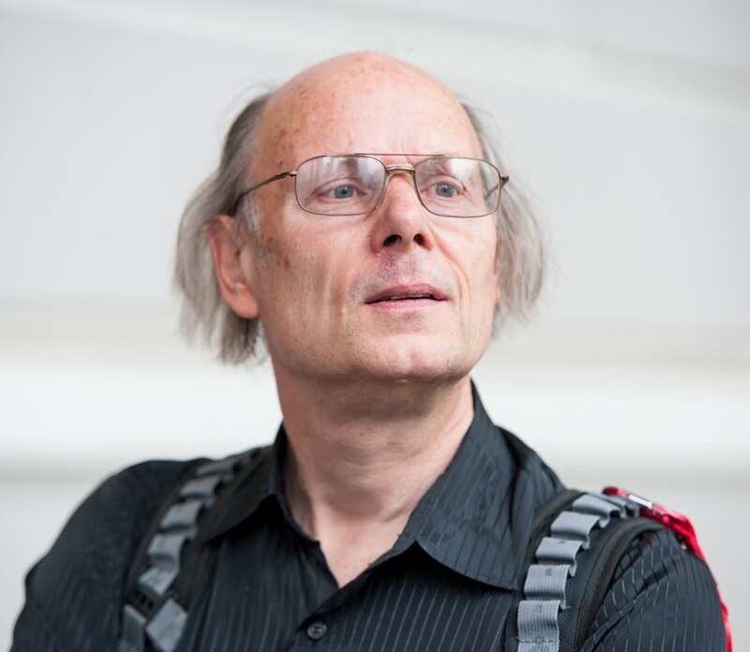
“Nobody should call themselves a professional if they only know one language” —Bjarne Stroustrup

Slide 44
C++ helps develop good coding hygiene
Am I using objects the way they’re meant to be used?
Type checking, type safety
Am I using memory efficiently?
Reference/copy semantics, move semantics
Am I modifiying something I’m not supposed to?
const and const correctness
Other languages relax these restrictions

Slide 45

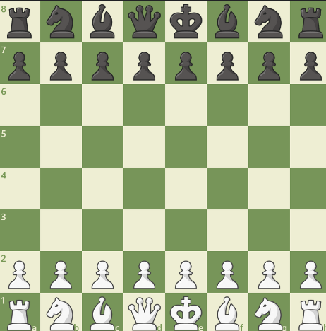

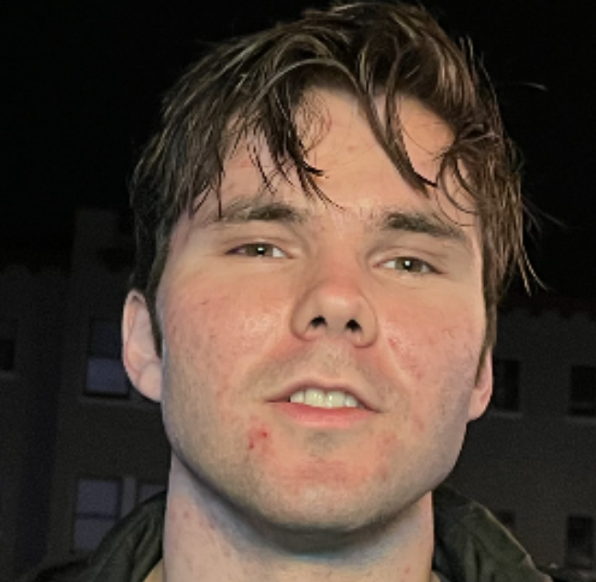
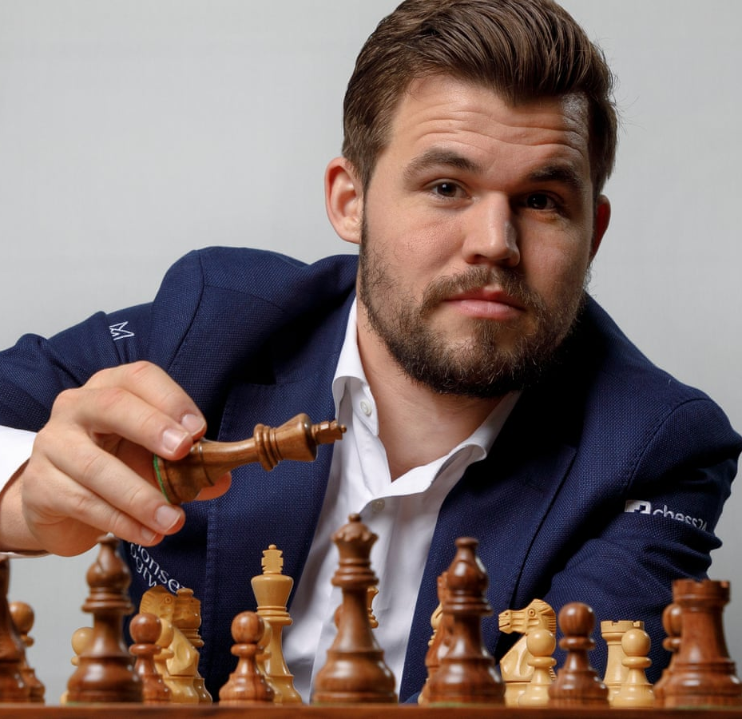



Magnus vs. Me

Slide 47
Course Logistics

Slide 48
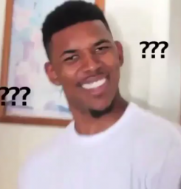
Asking Questions
We welcome questions!
Feel free to raise your hand at any time with a question
We'll also pause periodically to solicit questions and check understanding

Slide 49
Access and Accommodations
Disabled students are a valued and essential part of the Stanford community. We welcome you to our class!
Please work with OAE but also let us know if there's anything we can do to make the course more accessible to you.
Don't be shy about asking for accommodations if problems arise. We're​ very reasonable people and will do whatever we can to help.

Slide 50
Community Norms
Shame-free zone
Treat your peers and instructors with kindness and respect
Be curious
Communication is key!
Recognized we are all in-process (humility, question posing, avoid perfectionism)

Slide 51
Guiding Principles
We will do everything we can to support you. We want to provide flexibility to the best of our ability!
We want to hear your feedback so we can ensure the class is going as smoothly as possible for everyone
Please communicate with us if any personal circumstances or issues arise! We are here to support you :)

Slide 53
Lecture
Held Tuesdays and Thursdays from 3:00pm – 4:20pm in 260-113
Lecture is not recorded.
Attendance is required. Short participations quizzes (1-2 questions) will be given at the beginning of lecture starting in week 2. All students are given 2 free absences.

Slide 54
Illness
If you are sick, for the wellbeing of yourself and others please stay home, take care of yourself, and reach out to us – we never want you to feel that you must attend class if you are not feeling well!
Similarly, if you have an emergency or exceptional circumstance, please reach out to us so that we can help!

Slide 55
Office Hours
OH times are TBD and will be in person
These will be settled by week 2 (before the first assignment)
We want to talk to you! Come talk!
Extra OH weeks 9 – 10!
Watch the course website (cs106l.stanford.edu) and Ed for more info.

Slide 56
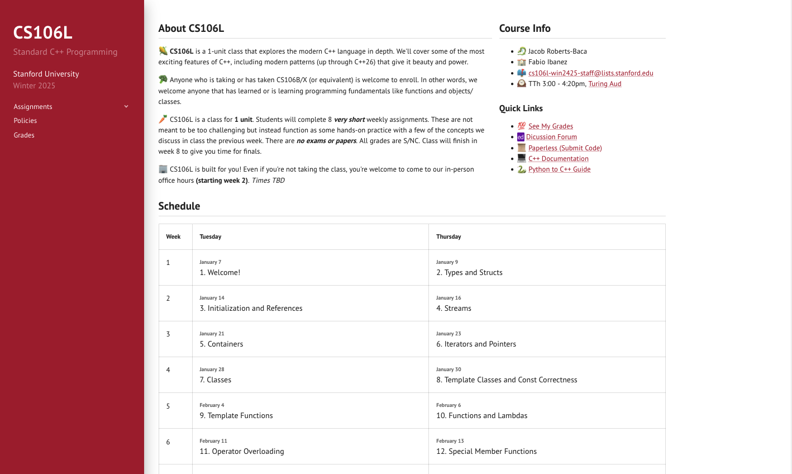

Slide 57
Assignments
There will be 8 short weekly assignments (typically will take 1 hour at most depending on experience)
Submissions will be on paperless as directed on the assignment handout!
Assignments will be released on Fridays and due in one week (the following Friday)
All students have three free late days.

Slide 58
Grading
Grading is S/NC. We expect everyone to get an S!
How do you get an S?
Attend 13 of the 15 lectures between Week 2 and Week 9
Successful completion of 6 out of 8 weekly assignments

Slide 59
Get in touch with us!
Here are the best ways to communicate with us!
Email us: cs106l-spr2425-staff@lists.stanford.edu
Please use this email and not our individual emails so we both receive the message!
Public or private post on Ed
After class or in our office hours

